Slide 1
Java RMI (Remote Method Invocation)

Slide 2
Distributed system, distributed computing
Early computing was performed on a single processor. Uni-processor computing can be called centralized computing.
A distributed system is a collection of independent computers, interconnected via a network, capable of collaborating on a task.
Distributed computing is computing performed in a distributed system.

Slide 3
Distributed Systems

Slide 4
Examples of Distributed systems
Network of workstations (NOW): a group of networked personal workstations connected to one or more server machines.
The Internet
An intranet: a network of computers and workstations within an organization, segregated from the Internet via a protective device (a firewall).

Slide 5
Centralized vs. Distributed Computing

Slide 6
Why distributed computing?
Economics: distributed systems allow the pooling of resources, including CPU cycles, data storage, input/output devices, and services.
Reliability: a distributed system allow replication of resources and/or services, thus reducing service outage due to failures.
The Internet has become a universal platform for distributed computing.

Slide 7
Dist. Computing: Weaknesses and Strengths
In any form of computing, there is always a trade off in advantages and disadvantages. Some of the reasons for the popularity of distributed computing :
The affordability of computers and availability of network access
Resource sharing
Scalability
Fault Tolerance

Slide 8
Dist. Computing: Weaknesses and Strengths
The disadvantages of distributed computing:
Multiple Points of Failures: the failure of one or more participating computers, or one or more network links, can spell trouble.
Security Concerns: In a distributed system, there are more opportunities for unauthorized attack.

Slide 9
Related Technologies
RPC (“Remote Procedure Calls”)
Developed by Sun
Platform-specific
CORBA (“Common Object Request Broker Architecture”)
Developed by OMG
Access to non-Java objects (as well as Java)
DCOM (“Distributed Component Object Model”)
Developed by Microsoft
Access to Win32 objects
LDAP (“Lightweight Directory Access Protocol”)
Finding resources on a network

Slide 10
RMI Overview
Remote Method Invocation (RMI) is a distributed systems technology that allows one Java Virtual Machine (JVM) to invoke object methods that will be run on another JVM located elsewhere on a network.
RMI is a Java technology that allows one JVM to communicate with another JVM and have it execute an object method. Objects can invoke methods on other objects located remotely as easily as if they were on the local host machine
Each RMI service is defined by an interface, which describes object methods that can be executed remotely. This interface must be shared by all developers who will write software for that service—it acts as a blueprint for applications that will use and provide implementations of the service.

Slide 11
What Is RMI?
Access to Remote Objects
Java-to-Java only
Client-Server Protocol
High-level API
Transparent
Lightweight

Slide 12
Remote Objects (Diagram)
Java Virtual Machine
Java Virtual Machine
TCP
Client Object
Remote Object

Slide 13
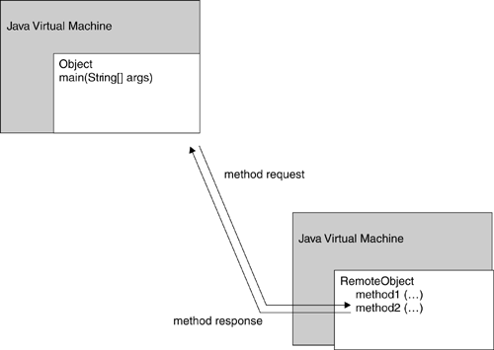
Remote method invocation
Invocation of a method on a remote object, executing on a remote machine

Slide 14
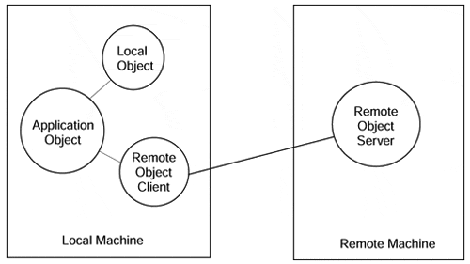
Local object – Remote object
Invocations on remote objects appear the same as invocations on local objects.

Slide 15
RMI Architecture - Layers
Java Virtual Machine
Java Virtual Machine
Client Object
Remote Object
Stub
Skeleton
TCP
Remote Reference Layer
Remote Reference Layer
Transport Layer
Transport Layer

Slide 16
RMI Architecture - Layers
Transport Layer − This layer connects the client and the server. It manages the existing connection and also sets up new connections.
Stub − A stub is a representation (proxy) of the remote object at client. It resides in the client system; it acts as a gateway for the client program.
Skeleton − This is the object which resides on the server side. stub communicates with this skeleton to pass request to the remote object.
RRL(Remote Reference Layer) − It is the layer which manages the references made by the client to the remote object.

Slide 17
RMI Registries
Name and look up remote objects
Servers can register their objects
Clients can find server objects and obtain a remote reference
A registry is a running process on a host machine

Slide 18
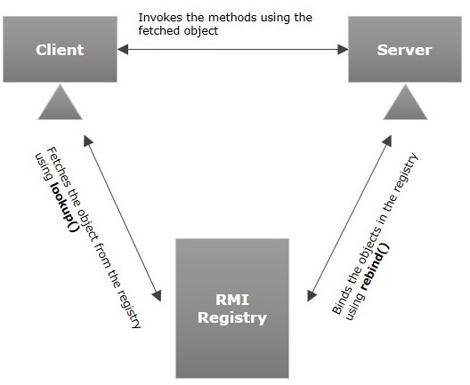
RMI Registries

Slide 19
Remote References and Interfaces
Remote References
Refer to remote objects
Invoked on client exactly like local object references
Remote Interfaces
Declare exposed methods
Implemented on client
Like a proxy for the remote object

Slide 20
Stubs and Skeletons
Stub
lives on client
pretends to be remote object
Skeleton
lives on server
receives requests from stub
talks to true remote object
delivers response to stub

Slide 21
Remote Interfaces and Stubs
Remote Interface
implements
implements
Client
Stub
Skeleton
Remote Object
(Server)

Slide 22
RMI System Architecture
Client Virtual Machine
Server Virtual Machine
Client
Remote Object
Skeleton
Stub
Server
“Fred”
Registry Virtual Machine

Slide 23
RMI Flow
1. Server Creates Remote Object 2. Server Registers Remote Object
Client Virtual Machine
Server Virtual Machine
Client
Remote Object
1
Skeleton
Stub
Server
2
“Fred”
Registry Virtual Machine

Slide 24
RMI Flow
3. Client requests object from Registry
4. Registry returns remote reference
(and stub gets created)
Client Virtual Machine
Server Virtual Machine
Client
Remote Object
Skeleton
Stub
Server
3
4
“Fred”
Registry Virtual Machine

Slide 25
RMI Flow
5. Client invokes stub method
6. Stub talks to skeleton
7. Skeleton invokes remote object
method
Client Virtual Machine
Server Virtual Machine
Client
Remote Object
5
7
6
Skeleton
Stub
Server
“Fred”
Registry Virtual Machine

Slide 26
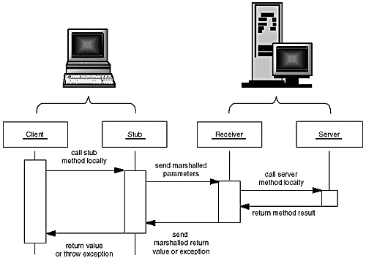
Parameter marshalling

Slide 27
RMI Applications
RMI applications are often comprised of two separate programs: a server and a client.
A typical server application creates some remote objects, makes references to them accessible, and waits for clients to invoke methods on these remote objects.
A typical client application gets a remote reference to one or more remote objects in the server and then invokes methods on them. RMI provides the mechanism by which the server and the client communicate and pass information back and forth.
Such an application is sometimes referred to as a distributed object application.

Slide 28
Java RMI Application
Define the remote interface
Develop the implementation class (remote object)
Develop the server program
Develop the client program
Compile the application
Execute the application

Slide 29
Defining the Remote Interface
A remote interface provides the description of all the methods of a particular remote object. The client communicates with this remote interface.
Create an interface that extends the predefined interface Remote which belongs to the package.
Declare all the business methods that can be invoked by the client in this interface.
Since there is a chance of network issues during remote calls, an exception named RemoteException may occur; throw it.
Define a Remote Interface
extends java.rmi.Remote

Slide 30
Designing a Remote Interface
package rmidemo;
import java.rmi.*;
public interface IProduct extends Remote{
String getDescription() throws RemoteException;
}

Slide 31
Developing the Implementation Class
In general the implementation class of a remote interface should at least
Declare the remote interfaces being implemented
Define the constructor for the remote object
Provide an implementation for each remote method in the remote interfaces
Define a class that implements the Remote Interface
extends java.rmi.RemoteObject
or java.rmi.UnicastRemoteObject

Slide 32
Implementing a Remote Interface
import java.rmi.*;
import java.rmi.server.*;
public class ProductImpl extends UnicastRemoteObject implements IProduct {
private String name;
public ProductImpl(String n) throws RemoteException {
super();
name = n;
}
public String getDescription() throws RemoteException {
return "I am a " + name + ". Buy me!";
}
}

Slide 33
Compiling Remote Classes
Compile the Java class
javac
reads .java file
produces .class file
Compile the Stub and Skeleton
rmic
reads .class file
produces _Skel.class and _Stub.class

Slide 34
Naming conventions for RMI classes
IProduct A remote interface
ProductImpl A server class implementing that interface
ProductImpl_Stub A stub class that is automatically generated by the rmic program
ProductImpl_Skel A skeleton class that is automatically generated by the rmic program needed for SDK 1.1
ProductServer A server program that creates server objects
ProductClient A client program that calls remote methods

Slide 35
RMI Applications for JDK 1.5
pregenerating a stub class for a remote object's class is only required if the remote object needs to support pre-5.0 clients. As of the 5.0 release, if a pregenerated stub class for a remote object's class cannot be loaded when the remote object is exported, the remote object's stub class is generated dynamically.
Designing a Remote Interface
Implementing a Remote Interface
Creating a RMI Server
Createing a RMI Client

Slide 36
RMI Applications for JDK 1.5
Creating a RMI Server
Creates and exports a Registry instance on the local host that accepts requests on the specified port Registry RMIReg = LocateRegistry.createRegistry(1099);
Creates a remote object ProductImpl EOS350D = new ProductImpl("Canon EOS 350D");
Binds a remote reference to the specified name in this registry RMIReg.bind("EOS350D", EOS350D);

Slide 37
RMI Applications for JDK 1.5
Creating a RMI Client
Getss a reference to the remote object Registry on the specified host and port. If host is null, the local host is used. Registry RMIReg = LocateRegistry.getRegistry("localhost",1099);
Lookups the service in the registry, and obtain a remote service Remote remoteService1 = RMIReg.lookup("EOS350D");
Cast to a Remote (Product) interface IProduct c1 = (IProduct) remoteService1;

Slide 38
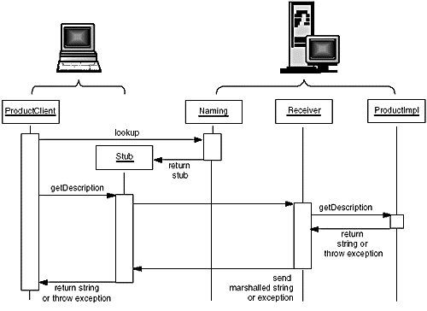
Calling the remote getDescription method

Slide 39
Remote Interfaces vs. Remote Classes
Remember that the reference is to an interface
You must make references, arrays, etc. out of the interface type, not the implementation type
You can’t cast the remote reference to a normal reference
So name your Remote Objects with “Impl” (so you don’t get confused)

Slide 40
Parameter Passing
Primitive types
passed by value
Remote objects
passed by reference
Non-remote objects
passed by value
uses Java Object Serialization

Slide 41
Java Serialization
Writes object as a sequence of bytes
Writes it to a Stream
Recreates it on the other end
Creates a brand new object with the old data

Slide 42
java.io.Serializable
Objects that implement the java.io.Serializable interface are marked as serializable
Also subclasses
Magically, all non-static and non-transient data members will be serialized
Actually, it’s not magic, it’s Reflection (it’s done with mirrors)
empty interface - just a marker
It’s a promise

Slide 43
Not All Objects Are Serializable
Any object that doesn’t implement Serializable
Any object that would pose a security risk
e.g. FileInputStream
Any object whose value depends on VM-specific information
e.g. Thread
Any object that contains a (non-static, non-transient) unserializable object (recursively)

Slide 44
NotSerializableException
thrown if you try to serialize or unserialize an unserializable object
maybe you subclassed a Serializable object and added some unserializable members

Slide 45
Serial Version UID
The serialVersionUID is a universal version identifier for a Serializable class. Deserialization uses this number to ensure that a loaded class corresponds exactly to a serialized object. If no match is found, then an InvalidClassException is thrown
Guidelines for serialVersionUID :
always include it as a field, for example: "private static final long serialVersionUID = 7526472295622776147L; " include this field even in the first version of the class, as a reminder of its importance
do not change the value of this field in future versions, unless you are knowingly making changes to the class which will render it incompatible with old serialized objects
new versions of Serializable classes may or may not be able to read old serialized objects; it depends upon the nature of the change;

Slide 46
Incompatible Changes
Adding or removing members
Changing a nonstatic field to static or a nontransient field to transient
Changing the declared type of a primitive field
. . . . . . . . . .
java.io.InvalidClassException thrown if you try to deserialize an incompatible object stream

Slide 47
Serial Version
If the changes were actually compatible
find out the Serial Version UID of the original class
use the serialver utility
add a member variable to the changed class
protected static final long serialVersionUID = -2215190743590612933L;
now it’s marked as compatible with the old class

Slide 48
Using Remote Method Invocation to Implement Callbacks

Slide 49
Java RMI Client Server Interaction

Slide 50
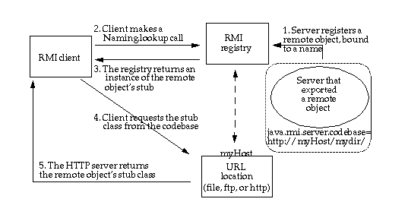
CodeBase
A codebase can be defined as a source, or a place, from which to load classes into a virtual machine

Slide 51
CodeBase
The remote object's codebase is specified by the remote object's server by setting the java.rmi.server.codebase property.The codebase set on the server VM is annotated to the remote object reference in the Java RMI registry.
The Java RMI client requests a reference to a named remote object. The reference (the remote object's stub instance) is what the client will use to make remote method calls to the remote object.
The Java RMI registry returns a reference (the stub instance) to the requested class. If the class definition for the stub instance can be found locally in the client's CLASSPATH , which is always searched before the codebase, the client will load the class locally. However, if the definition for the stub is not found in the client's CLASSPATH, the client will attempt to retrieve the class definition from the remote object's codebase.

Slide 52
CodeBase
The client requests the class definition from the codebase. The codebase the client uses is the URL that was annotated to the stub instance when the stub class was loaded by the registry.
The class definition for the stub (and any other class(es) that it needs) is downloaded to the client.
Now the client has all the information that it needs to invoke remote methods on the remote object. The stub instance acts as a proxy to the remote object that exists on the server;
In addition to downloading stubs and their associated classes to clients, the java.rmi.server.codebase property can be used to specify a location from which any class, not only stubs, can be downloaded.

Slide 53
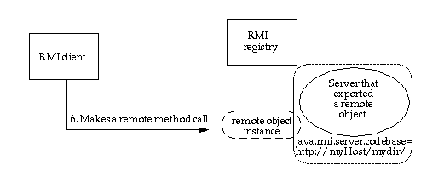
CodeBase
Java RMI client making a remote method call

Slide 54
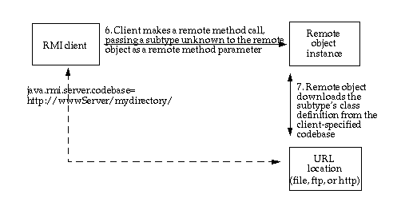
CodeBase
Java RMI client making a remote method call, passing an unknown subtype as a method parameter

Slide 55
Preparing for Deployment
Deploying an application that uses RMI can be tricky because so many things can go wrong and the error messages that you get when something does go wrong are so poor. Separate the class files into three subdirectories:
server
download
client
The server directory contains all files that are needed to run the server. You will later move these files to the machine running the server process. In our example, the server directory contains the following files:
server/
ProductServer.class
ProductImpl.class
Product.class

Slide 56
Preparing for Deployment
The client directory contains the files that are needed to start the client
client/
ProductClient.class
Product.class
client.policy
You will deploy these files on the client computer. Finally, the download directory contains those class files needed by the RMI registry, the client, and the server, as well as the classes they depend on. In our example, the download directory looks like this:
download/
ProductImpl_Stub.class
java - Djava.rmi.server.codebase = http://localhost:8080/ download/ ProductServer &

Slide 57
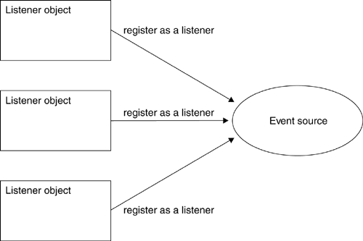
Using RMI to Implement Callbacks
Multiple listeners can register with one or more event sources.

Slide 58
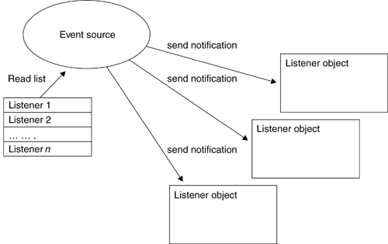
Using RMI to Implement Callbacks
Callback notification of event, for every registered listener

Slide 59
Callback Client-Server Interactions

Slide 60
Defining the Listener Interface
The listener interface defines a remote object with a single method. This method should be invoked by an event source whenever an event occurs, so as to act as notification that the event occurred. The method signifies a change in temperature, and allows the new temperature to be passed as a parameter.
interface TemperatureListener extends Remote {
public void temperatureChanged(double temperature)
throws java.rmi.RemoteException;
}

Slide 61
Defining the Event Source Interface
The event source must allow a listener to be registered and unregistered, and may optionally provide additional methods. In this case, a method to request the temperature on demand is offered.
interface TemperatureSensor extends java.rmi.Remote{
public double getTemperature()
throws java.rmi.RemoteException;
public void addTemperatureListener
(TemperatureListener listener )
throws java.rmi.RemoteException;
public void removeTemperatureListener
(TemperatureListener listener )
throws java.rmi.RemoteException;
}

Slide 62
Implementing the Event Source Interface
A TemperatureSensorServerImpl class is defined, which acts as an RMI server.
To notify registered listeners as a client (The server must extend UnicastRemoteObject, to offer a service, and implement the Temperature Sensor interface.
To create an instance of the service and registering it with the rmiregistry
To launch a new thread, responsible for updating the value of the temperature, based on randomly generated numbers.
As each change occurs, registered listeners are notified, by reading from a list of listeners stored in a java.util.Vector object. This list is modified by the remote addTemperatureListener(TemperatureListener) and removeTemperatureListener(TemperatureListener) methods.

Slide 63
Implementing the Event Source Interface
public class TemperatureSensorImpl extends UnicastRemoteObject implements TemperatureSensor, Runnable {
private volatile double temp; private Vector list = new Vector();
public TemperatureSensorImpl() throws java.rmi.RemoteException {
super();
temp = 98.0; // Assign a default setting for the temperature
}
public double getTemperature() throws java.rmi.RemoteException {
return temp;
}
public void addTemperatureListener(TemperatureListener listener) throws java.rmi.RemoteException {
System.out.println("adding listener -" + listener);
list.add(listener);
}
public void removeTemperatureListener(TemperatureListener listener) throws java.rmi.RemoteException {
System.out.println("removing listener -" + listener);
list.remove(listener);
}

Slide 64
Implementing the Event Source Interface
public void run() {
Random r = new Random();
for (; ; ) {
try {
// Sleep for a random amount of time
int duration = r.nextInt() % 10000 + 2000;
// Check to see if negative, if so, reverse
if (duration < 0) duration = duration * -1;
Thread.sleep(duration);
} catch (InterruptedException ie) {}
// Get a number, to see if temp goes up or down
int num = r.nextInt();
if (num < 0) temp += 0.5; else temp -= 0.5;
notifyListeners(); // Notify registered listeners
}}

Slide 65
Implementing the Event Source Interface
private void notifyListeners() {
// Notify every listener in the registered list
for (Enumeration e = list.elements(); e.hasMoreElements();) {
TemperatureListener listener = (TemperatureListener)
e.nextElement();
// Notify, if possible a listener
try {
listener.temperatureChanged(temp);
} catch (RemoteException re) {
System.out.println("removing listener -" + listener);
// Remove the listener
list.remove(listener);
} }
} }

Slide 66
Implementing the Listener Interface
The temperature monitor client must implement the TemperatureListener interface, and register itself with the remote temperature sensor service, by invoking the TemperatureSensor.addTemperatureListener (Temperature Listener) method.
By registering as a listener, the monitor client will be notified of changes as they occur, using a remote callback. The client waits patiently for any changes, and though it does not ever remove itself as a listener, functionality to achieve this is supplied by the
TemperatureSensor.removeTemperatureListener( TemperatureListener)
method.

Slide 67
Implementing the Listener Interface
import java.rmi.*;
import java.rmi.server.*;
public class TemperatureListenerImpl extends UnicastRemoteObject implements TemperatureListener {
// Default constructor throws a RemoteException
public TemperatureListenerImpl() throws RemoteException {
super();
}
public void temperatureChanged(double temperature) throws java.rmi.RemoteException {
System.out.println("Temperature change event : " + temperature);
}
}

Slide 68
TemperatureSensorServer
public class TemperatureSensorServer{
public static void main(String args[]) {
System.out.println("Loading temperature service");
try {
// Load the service
TemperatureSensorImpl sensor = new TemperatureSensorImpl();
// Register with service so that clients can find us
String registry = "localhost";
String registration = "rmi://" + registry + "/TemperatureSensor";
Naming.rebind(registration, sensor);
// Create a thread, and pass the sensor server. This will activate the //run() method, and trigger regular temperature changes.
Thread thread = new Thread(sensor);
thread.start();
} catch (RemoteException re) {
System.err.println("Remote Error - " + re);
} catch (Exception e) {
System.err.println("Error - " + e);
}
}}

Slide 69
TemperatureMonitor
public static void main(String args[]) {
System.out.println("Looking for temperature sensor");
try {
// Lookup the service in the registry, and obtain a remote service
String registry = "localhost";
String registration = "rmi://" + registry + "/TemperatureSensor";
Remote remoteService = Naming.lookup(registration);
// Cast to a TemperatureSensor interface
TemperatureSensor sensor = (TemperatureSensor) remoteService;
// Get and display current temperature
double reading = sensor.getTemperature();
System.out.println("Original temp : " + reading);
// Create a new monitor and register it as a listener with remote sensor
TemperatureListenerImpl monitor = new TemperatureListenerImpl();
sensor.addTemperatureListener(monitor);
} catch (RemoteException re) {
System.out.println("RMI Error - " + re);
} catch (Exception e) {
System.out.println("Error - " + e);
} }

Slide 70
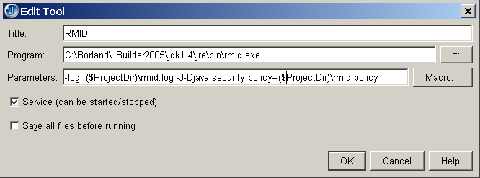
Configuring a RMID

